Slide 1
Deforestation

Slide 2
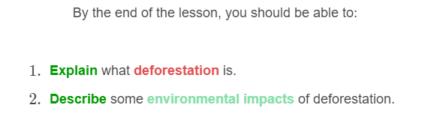
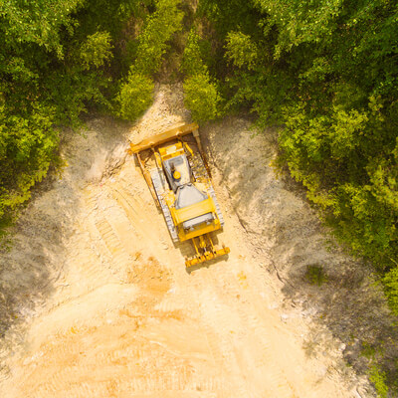

Slide 3
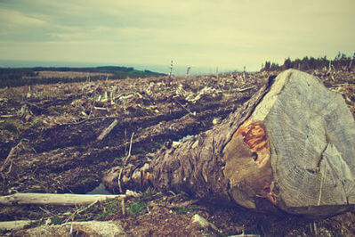
What is deforestation?
Deforestation is the permanent destruction of forests in order to make the land available for other uses.
Deforestation destroys the habitats of many species. This reduces their survival rate and can even lead to the local extinction of a population.

Slide 4
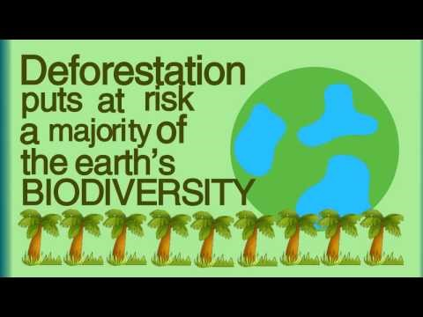

Slide 5
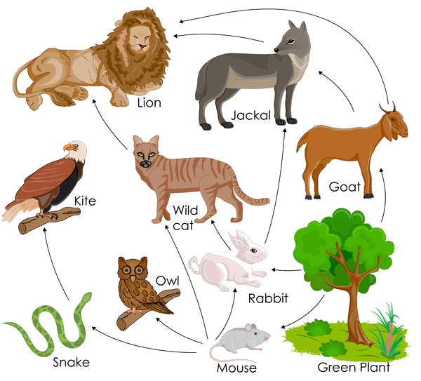
Deforestation disrupts the balance of an ecosystem by removing producers.
Most food chains begin with producers, therefore deforestation removes food sources for many consumers.

Slide 6
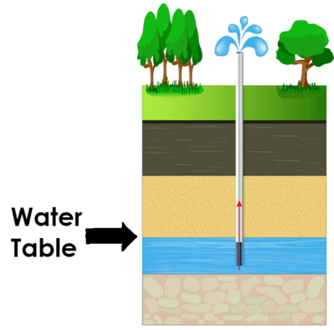
Deforestation also lowers an area's water table.
The water table is the upper level of an underground surface in which the soil or rocks are permanently saturated with water.
Plants are responsible for drawing water in to an area, and maintaining the water cycle. When plants are chopped down, they can no longer draw in water. This brings less rain to the area, making the soil too dry to support other plants and animals.

Slide 7
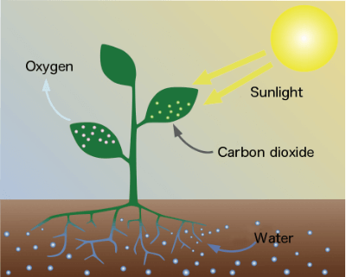
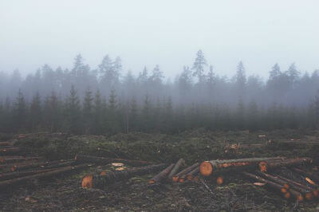
Deforestation can lead to an increase in the amount of carbon dioxide in the atmosphere.
Plants are made up of carbon. When we burn trees to clear land, the carbon is released as carbon dioxide. Higher levels of carbon dioxide in the atmosphere contribute to climate change.
Deforestation also reduces the number of trees that can convert carbon dioxide to oxygen.

